Slide 1
Free-time activities
Talashkevich Daniil
B01-009
MIPT
2021

Slide 2
Plan
What FT-activities are?
The types of activities people choose in nowadays
What activities do I prefer?

Slide 3

What FT-activities are?
rest
fun
https://thedailyroarws.org/2426/tips-fyi/three-activities-for-your-free-time/

Slide 4
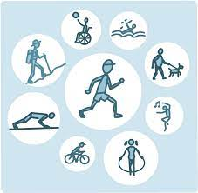
The types of activities
physical activity
reading
https://newsinhealth.nih.gov/2020/07/personalized-exercise

Slide 5

What activities do I prefer?
mind
body
https://www.realsimple.com/health/preventative-health/benefits-of-reading-real-books

Slide 6
Summary
What FT-activities are?
The types of activities people choose in nowadays
What activities do I prefer?

Slide 7
Conclusion
Time is the coin of your life. You only have this coin, and only you have the right to determine what it should be spent on. Beware that it has not been spent by anyone else.
  Carl Sandburg,
  American poet

